Slide 1
ML PROJECT
TOPIC- Credit Card Fraud Detection

Slide 2
Problem Statement & AIM :
Credit Card Fraud Detection
Given a dataset with anonymized credit card transactions labeled as fraudulent or genuine,we have to detect whether a transaction perfomed is fraudulent or genuine.

Slide 3
About the dataset :
The datasets contains transactions made by credit cards in September 2013 by european cardholders. Source:Kaggle.com.
The data set does not contain any NULL values.
This dataset contains transactions that occurred in two days, having details of 492 frauds out of 284,807 transactions. The dataset is unbalanced, the positive class (frauds) account for 0.17% of all transactions.
It contains only numerical input variables.

Slide 4
contd...
Features V1, V2, … V28 are the principal components obtained with PCA, the only features which have not been transformed with PCA are 'Time' and 'Amount'.
Feature 'Time' contains the seconds elapsed between each transaction and the first transaction in the dataset. The feature 'Amount' is the transaction Amount, this feature can be used for example-dependant cost-senstive learning.
Feature 'Class' is the response variable and it takes value 1 in case of fraud and 0 otherwise.

Slide 5
Algorithms used:
Since this is a classification problem(Supervised ML type), the algos used in the model are: (i) Logistic Regression
(ii) SVM
(iii) Random Forest
(iv) KNN
The abve four algorithm are used to predict the scores of training and testing data from the file “creditcard.csv”.

Slide 6
Steps Applied:
Loaded the dataset and calculated the outlier fraction. It came out to be 0.17% which states that data is imbalanced.
Stored the class column into y(target),and stored the features(time, v1 v2...v28 ,amount) to x.
Graph was plotted for transaction class ditribution.
Train test split was applied
Now applied Logistic regression,first by taking the dataset as a whole,then also by handling the imbalanced dataset using class_weight just to check the difference in accuracy score.

Slide 7
contd...
Now applied SVM algo and predicted train-test scores respectively.
Then applied Random Forest.
Then KNN was applied.
In KNN,normalization was applied for amount column so as to bring all features to same scale.
Calculated the classification report for every algorithm.
For every algorithm,confusion matrix was also calculated.

Slide 8
Observation:
From the model,the following are the accuracy scores predicted from dataset,for each algorithm:
Logistic Regression: 95.48%
SVM: 99.83%
Random Forest: 99.96%
KNN: 99.84%

Slide 9
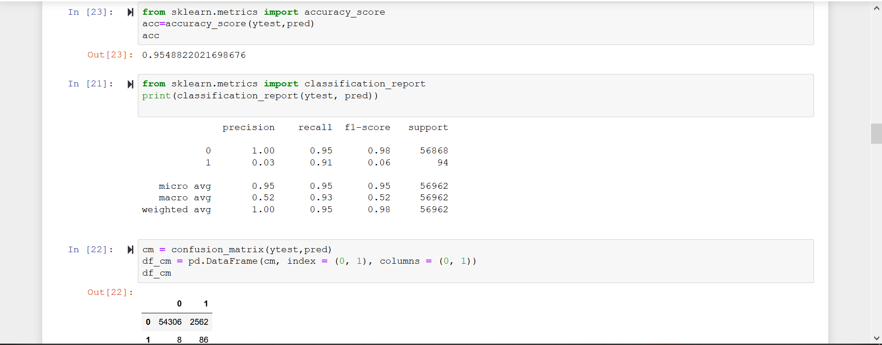
Logistic Regression:

Slide 10
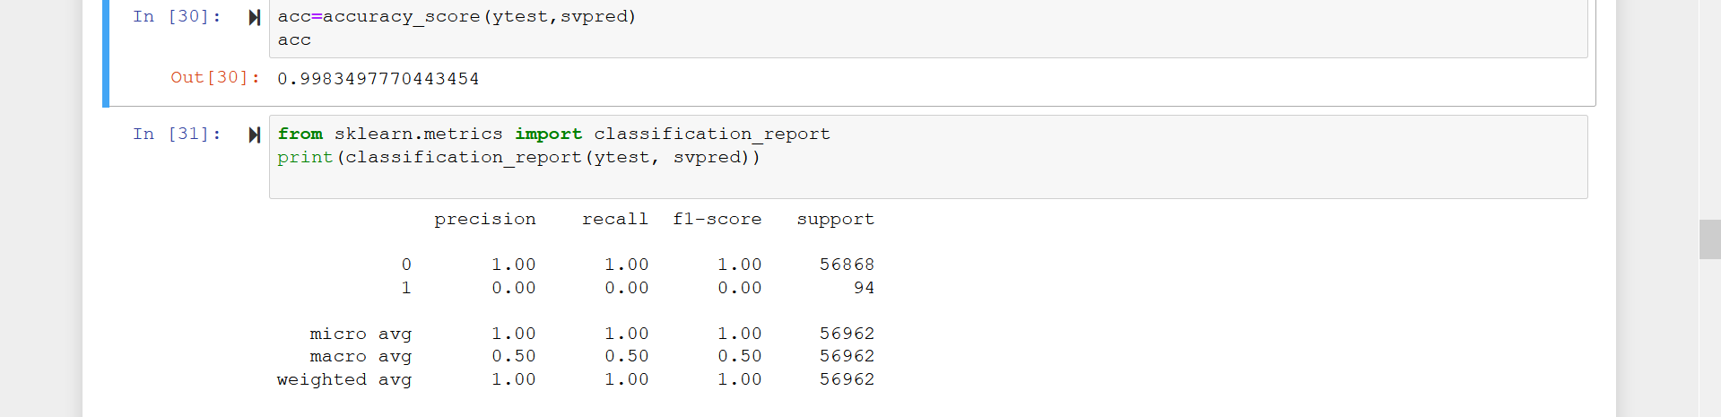
SVM:

Slide 11
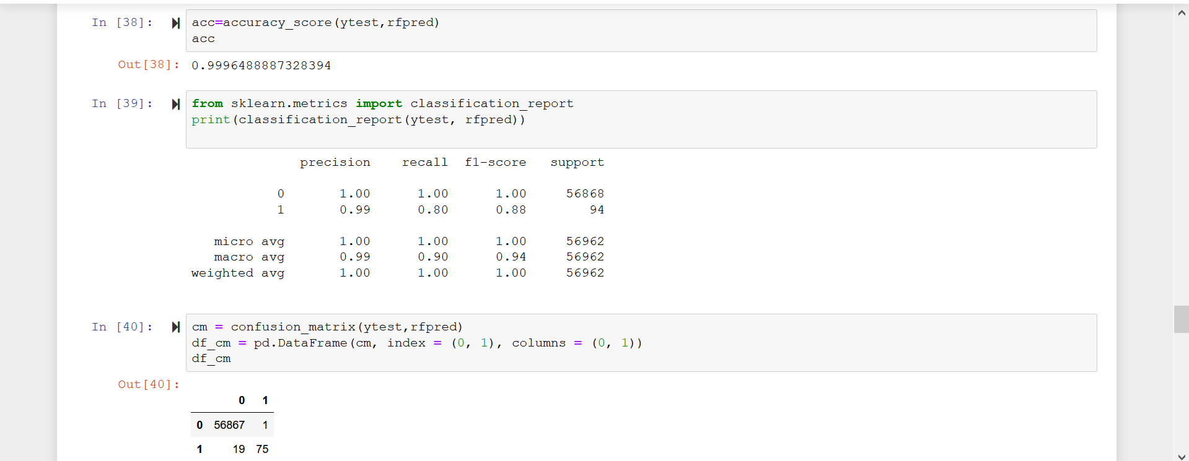
RandomForest

Slide 12
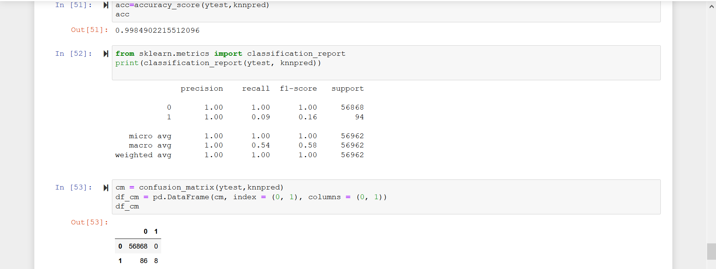
KNN:

Slide 13
Suitable Algorithm for the given dataset:
Four algos were tested against the dataset and scores were predicted for each algo.
However,all the algos predicted very near/close scores,the Random Forest algo works well as it provides most best score for both training set and testing set.

Slide 14
Acknowledgement
I would lIke to thank IIT Kanpur ICT academy for providing me this opportunity.I would like to thank Vinit sir for his guidance and Rahul sir for his mentoring.
During the entire course,I learned a lot about Machine Learning and its various implementations on real world problems.This encouraged me to work on a credit card fraud detection project.

Slide 15
THANK YOU Presented by- MAYANK KISHOR

